Slide 1
Unit 4 Energy & Power
Part B: Power in an Electric Circuit

Slide 2
What will you learn?
What voltage source and current source are.
Calculate power of a simple circuit.

Slide 3

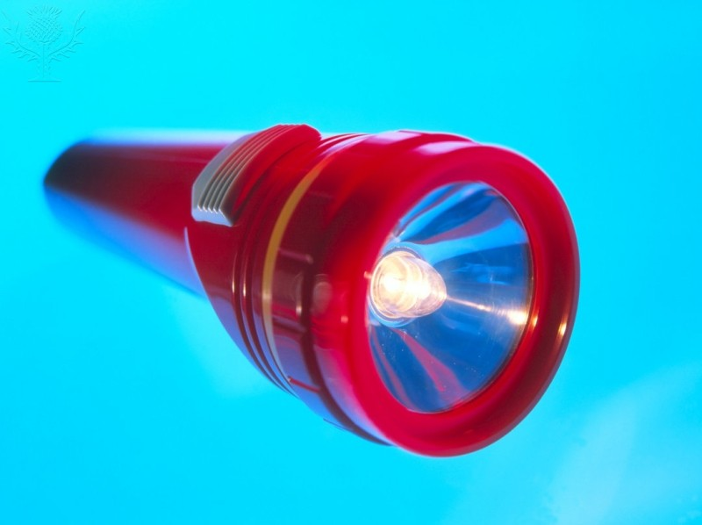
Power source
Scenario 1: When you switch on your torch, it lights up...
Where is the source of energy that lights up your torch?

Slide 4

Power source
Scenario 2: When you play your electric guitar, you sing to the tune …
What is the source of energy that amplifies the sound from the strings?

Slide 5
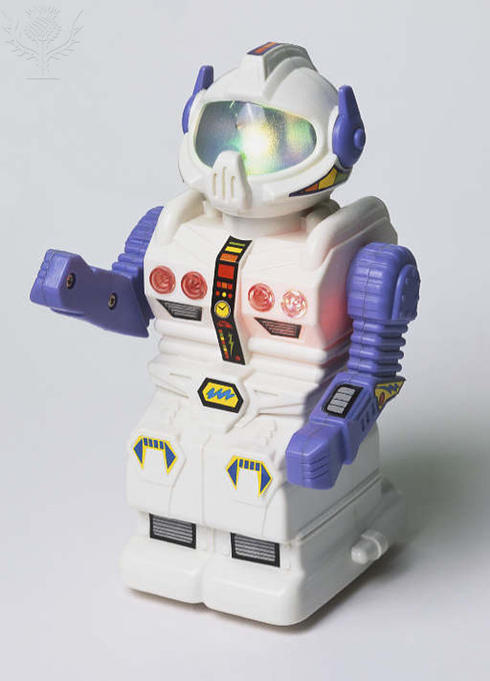
Power source
Scenario 3: When you play with your toy robot at home, it moves with lights flickering and perhaps saying hello to you …
Where is the source of energy of the robot?

Slide 6
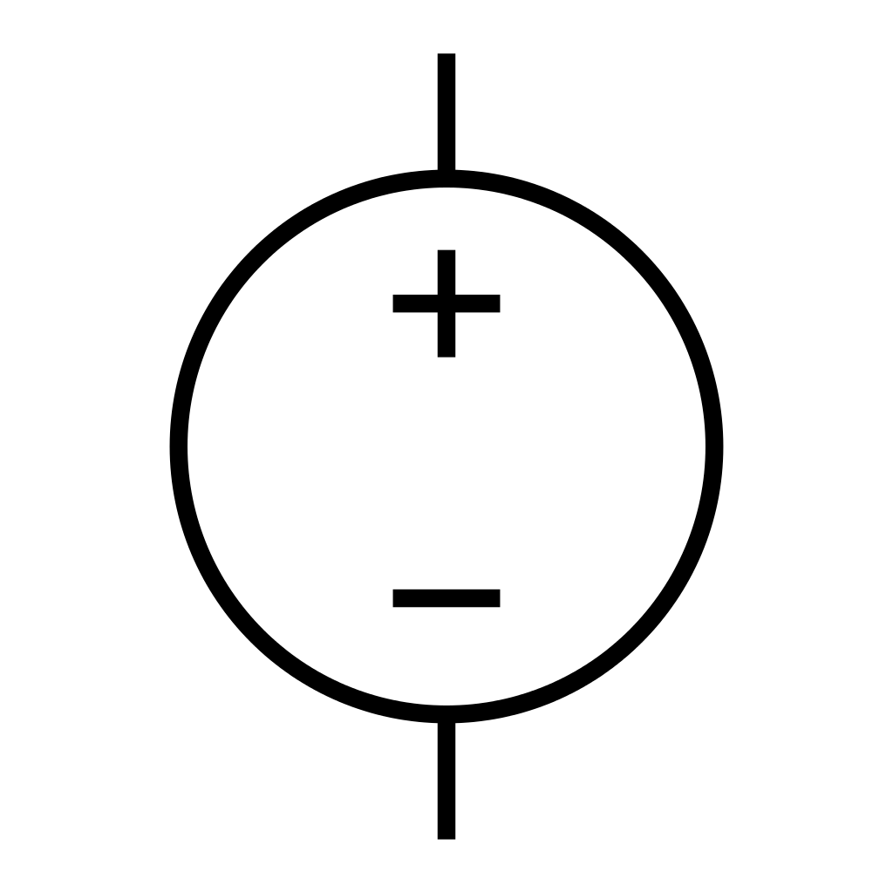
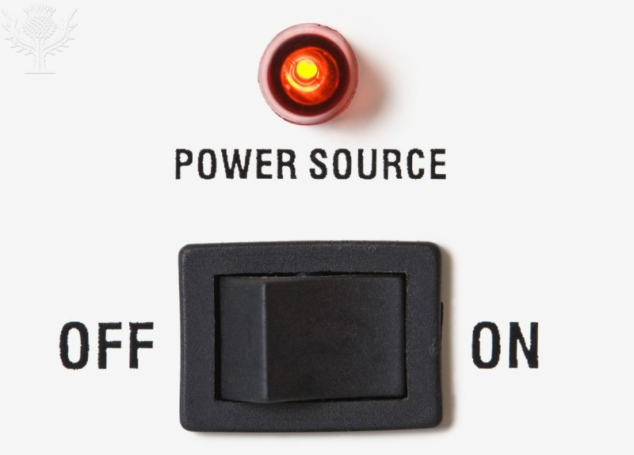

Power source
A gadget requiring electricity to operate is said to be powered by electricity.
The source of the electrical energy for a circuit is referred to as the power source of the circuit.
An electrical power source can be a voltage source or a current source.
Voltage source
Current source

Slide 7
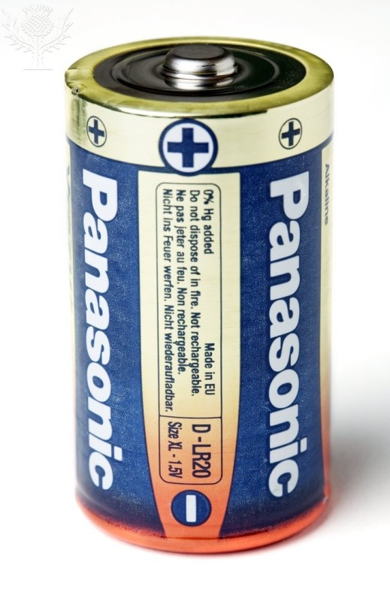
Voltage Source
An ideal voltage source is able to provide stable output voltage with constant amplitude regardless of the power consumption of the load.
Examples of voltage sources: Car battery, Li-ion battery, battery charger, power adaptor for LED display, and etc.
Voltage source is also called voltage supply.

Slide 8
Current Source
An ideal current source is able to provide stable output current with constant amplitude regardless of the power consumption of the load.
Unlike voltage sources, a current source is in fact an electronic circuit which provides a stable output current. This electronic circuit in itself is powered by a voltage source.
Applications:
Battery charger
Power up dc motor for fixed torque, T ∝ I.

Slide 9
Power Flow Direction
+
_
+
_
In this circuit, the power source is a dc voltage source, e.g. a battery or a dc power adaptor.
The power source delivers (outputs) power to the load.
I
I
P
R
V
I
Power flow
Source
Load
A load can be a resistor, a light bulb, or an electric appliance.

Slide 10
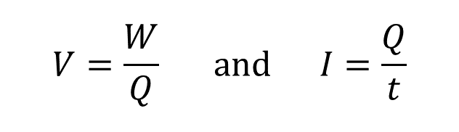
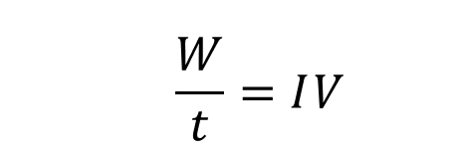


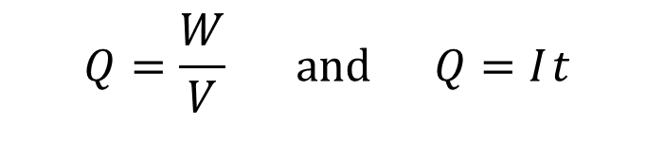
Power Formula
$$Therefore, \frac{W}{V}=I t$$
In Unit 2, you learned
$$V=\frac{W}{Q} and I=\frac{Q}{t}$$
$$\frac{W}{t}=I V$$
where
W is the work done or energy,
Q is the charge.
$$P=VI$$
The power delivered from a power source
= Voltage of the power source × Current of the power source.
Rearrange the two equations.
$$Q=\frac{W}{V} and Q=I t$$
The power consumed or dissipated by a component
= Voltage across of the component × Current in the component.

Slide 11
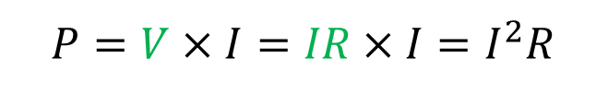
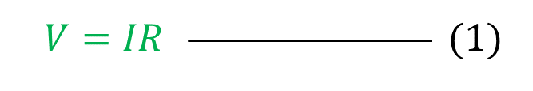

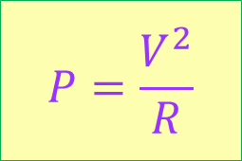

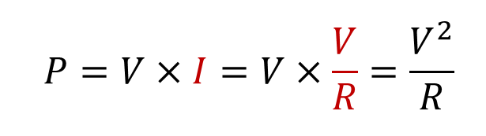


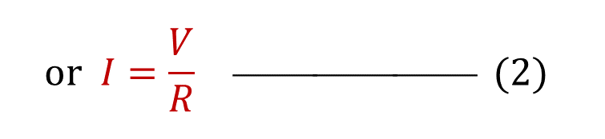

Power Formula
$$P=VI$$
$$(3)$$
Ohm’s law:
$$V=IR  (1)$$
$$Substitue \left(1\right) into (3)$$
$$or I=\frac{V}{R}  (2)$$
$$P=V×I=IR×I=I^{2}R$$
$$P=I^{2}R$$
$$Substitue \left(2\right) into (3)$$
$$P=V×I=V×\frac{V}{R}=\frac{V^{2}}{R}$$
$$P=\frac{V^{2}}{R}$$

Slide 12

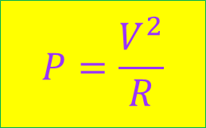

Power Formula
All 3 formulas can be applied to calculate the power consumption or power dissipation of any resistive components or devices, such as, resistor, incandescent light bulb and any resistive wire.
P = VI can also be used to calculate the output power of any electrical power sources.
$$P=\frac{V^{2}}{R}$$
$$P=I^{2}R$$
$$P=VI$$

Slide 13
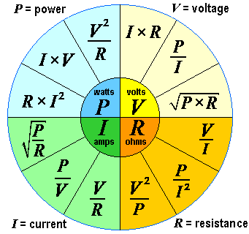
Power Expressions
Ohm’s law and power expressions relating to V, I and R are depicted in the pictorial diagram.

Slide 14

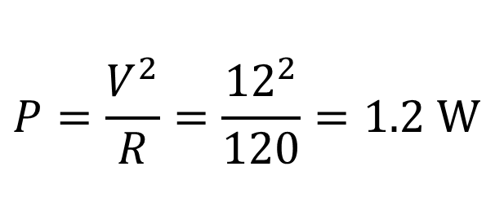
Example 1: A 12 V supply is connected across a 120 Ω resistor. Determine the power dissipation of the resistor.
$$P=\frac{V^{2}}{R}=\frac{{12}^{2}}{120}=1.2 W$$
I
+
_
V
R

Slide 15

Example 2: A 100 V supply is connected across a 50 W light bulb. Determine the current in the circuit.
$$I=\frac{P}{V}=\frac{50}{100}=0.5 A$$
+
_
I
V
R

Slide 16


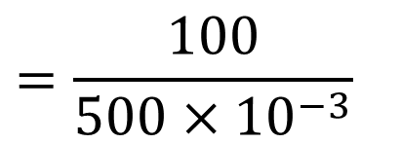
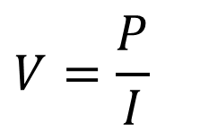
Example 3: A 100 W light bulb is connected to a voltage supply. The circuit current is 500 mA. Determine the supply voltage.
$$V=\frac{P}{I}$$
+
_
I
V
R
$$=\frac{100}{500×{10}^{−3}}$$
$$=0.2×{10}^{3} V$$
$$=200 V$$

Slide 17
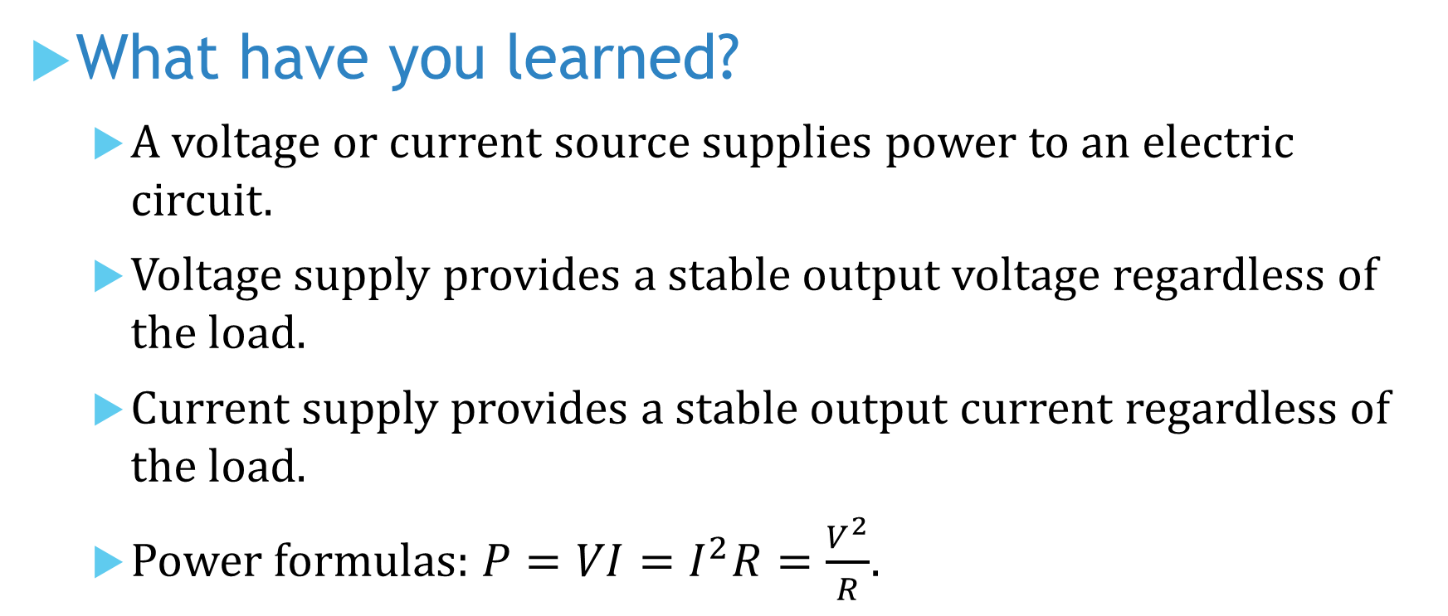
What have you learned?
A voltage or current source supplies power to an electric circuit.
Voltage supply provides a stable output voltage regardless of the load.
Current supply provides a stable output current regardless of the load.
Power formulas: $P=VI=I^{2}R=\frac{V^{2}}{R}$.

Slide 18
Coming Up Next
Resistor Power Ratings

